Slide 1
Predix
Asset Lifecycle Manager

Slide 2

WestCoast Air just purchased Predix
Bob Smith is the aircraft manager at WestCoast Air. His boss purchased Predix to improve maintenance efficiency.
Bob has one week to get all of his aircraft and parts into Predix.

Slide 3
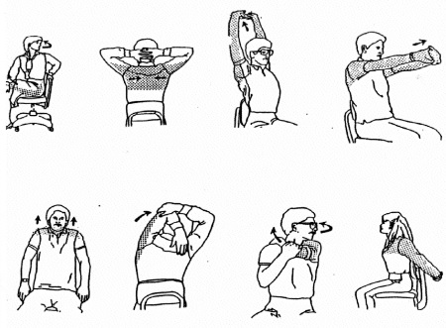
Predix is new to everyone at WestCoast Air.
What is Bob to do? He doesn’t even have time for his stress reduction techniques!

Slide 4
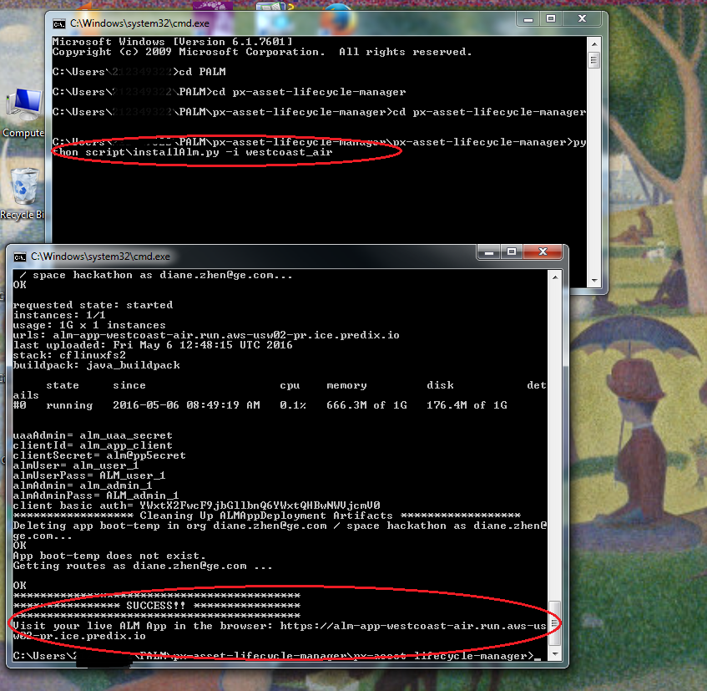
Predix Asset Lifecycle Manager TO THE RESCUE!
Jody, the WestCoast Air IT Manager, installs Predix Asset Lifecycle Manager with one easy command!

Slide 5
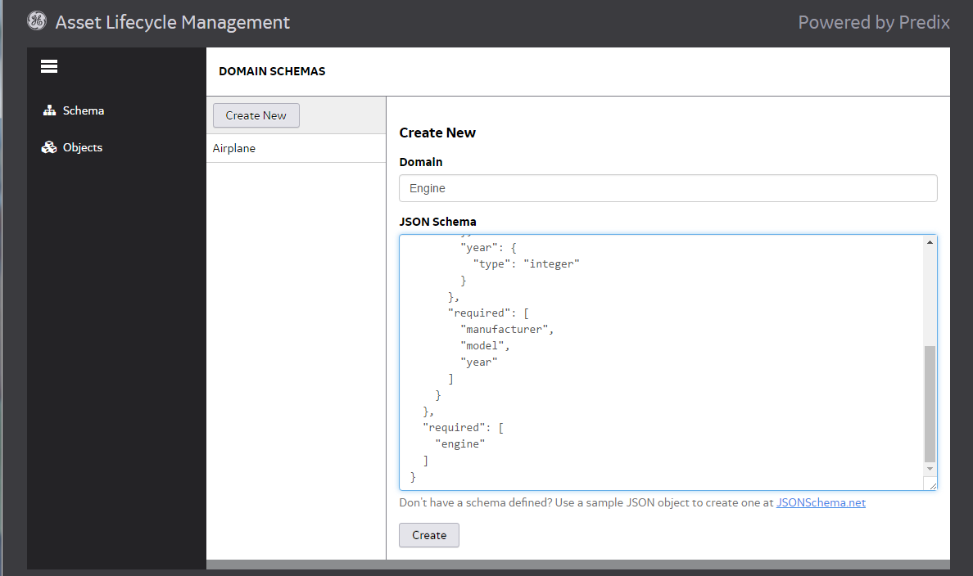
Predix Asset Lifecycle Manager TO THE RESCUE!
Now Bob, armed with schemas he and Jody have designed, can load his fleet definitions into PALM

Slide 6
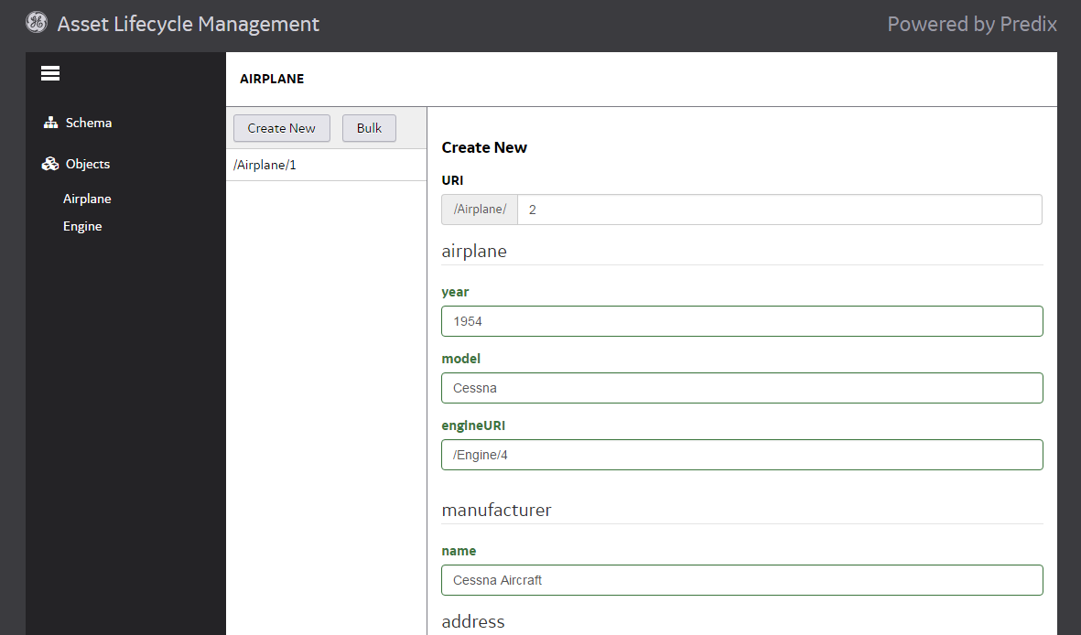
Predix Asset Lifecycle Manager TO THE RESCUE!
PALM immediately provides Bob with user friendly, intuitive navigation and screens to enter in all of his airplanes and parts!

Slide 7
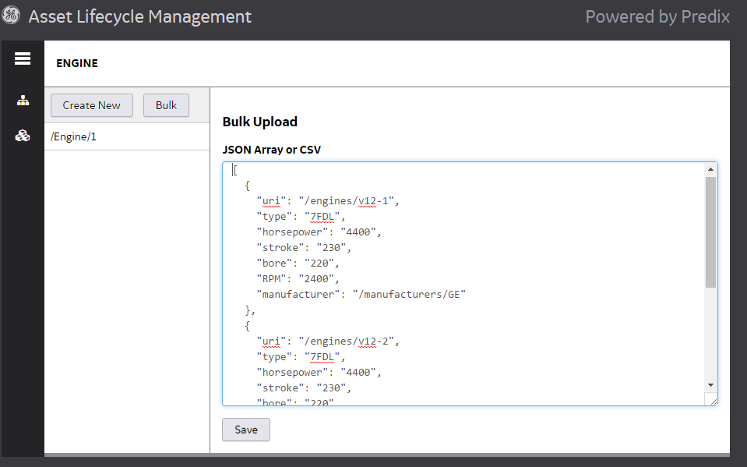
Predix Asset Lifecycle Manager TO THE RESCUE!
With bulk upload, Bob is able to enter his fleet assets into Predix with time to spare.
Bob is even able to make adjustments when one of his planes is given a new part!

Slide 8

Predix Asset Lifecycle Manager TO THE RESCUE!
WestCoast Air realizes millions in cost savings and decides to open a branch on the East Coast. Everyone celebrates!

